Slide 1




SURVEY
ANALYSIS
Amir Mohamed

Slide 2

01
02
03
OVERVIEW
About the dataset
The vision
Insights

Slide 3

01
ABOUT DATASET
This dataset contains responses from a survey of data professionals, covering various aspects of their careers and job satisfaction.
Here's a breakdown of the features present in the data:
Demographics & Technical Background:
Unique ID: A unique identifier for each survey respondent.
Email: The email address of the respondent (anonymized as "anonymous").
Date Taken: The date when the survey was completed.
Time Taken: The time of day when the survey was completed.
Browser: The web browser used by the respondent.
OS: The operating system used by the respondent.
City: The city where the respondent is located.
Country: The country where the respondent is located.
Referrer: The source from which the respondent accessed the survey.
Time Spent: The duration spent by the respondent on the survey.

Slide 4
01
ABOUT DATASET
The data also contains some question-based columns, like:
Q1 - Which Title Best Fits your Current Role?: The job title of the respondent.
Q2 - Did you switch careers into Data?: Indicates if the respondent transitioned into the data field.
Q3 - Current Yearly Salary (in USD): The annual salary range of the respondent.
Q4 - What Industry do you work in?: The industry in which the respondent is employed.
Q5 - Favorite Programming Language: The programming language preferred by the respondent.
Q7 - How difficult was it for you to break into Data?: The perceived difficulty of entering the data field.
Q8 - If you were to look for a new job today, what would be the most important thing to you?: The primary factor influencing a job search.
Q9 - Male/Female?: The gender of the respondent.
Q10 - Current Age: The age of the respondent.
Q11 - Which Country do you live in?: The country of residence for the respondent.
Q12 - Highest Level of Education: The highest educational attainment of the respondent.
Q13 - Ethnicity: The ethnic background of the respondent.
Job Satisfaction & Experience:
Q6 - How Happy are you in your Current Position with the following? (Salary): Satisfaction level with salary.
Q6 - How Happy are you in your Current Position with the following? (Work/Life Balance): Satisfaction level with work-life balance.
Q6 - How Happy are you in your Current Position with the following? (Coworkers): Satisfaction level with colleagues.
Q6 - How Happy are you in your Current Position with the following? (Management): Satisfaction level with management.
Q6 - How Happy are you in your Current Position with the following? (Upward Mobility): Satisfaction level with career progression opportunities.
Q6 - How Happy are you in your Current Position with the following? (Learning New Things): Satisfaction level with learning opportunities.

Slide 5
02
VISION
01
What is the average happiness rate with work life balance?
02
What is the average happiness rate with salary ?
03
What is the average age of the survey takers?
04
What is the count of employees for each industry?
05
What is the Distribution of survey takers by gender?
06
What is the Average salary by role job?

Slide 6
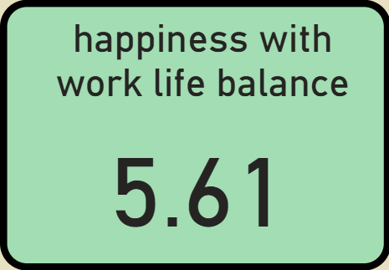
01
What is the average happiness rate with work life balance?

Slide 7
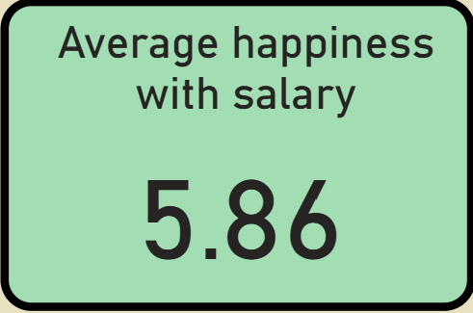
02
What is the average happiness rate with salary ?

Slide 8
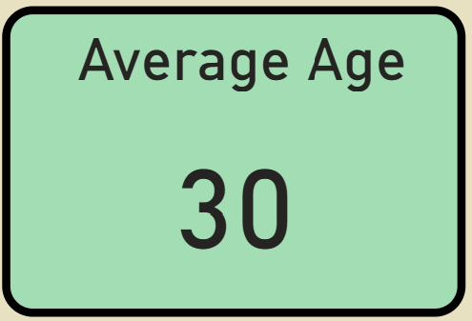
03
What is the average age of the survey takers?

Slide 9
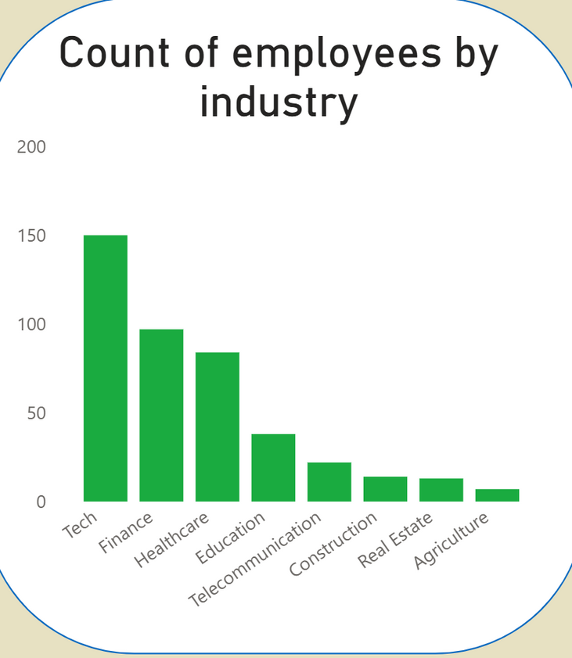
04
What is the count of employees for each industry?

Slide 10
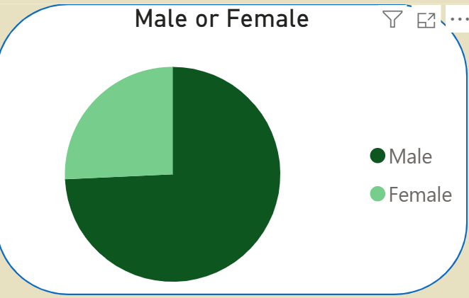
05
What is the Distribution of survey takers by gender?

Slide 11
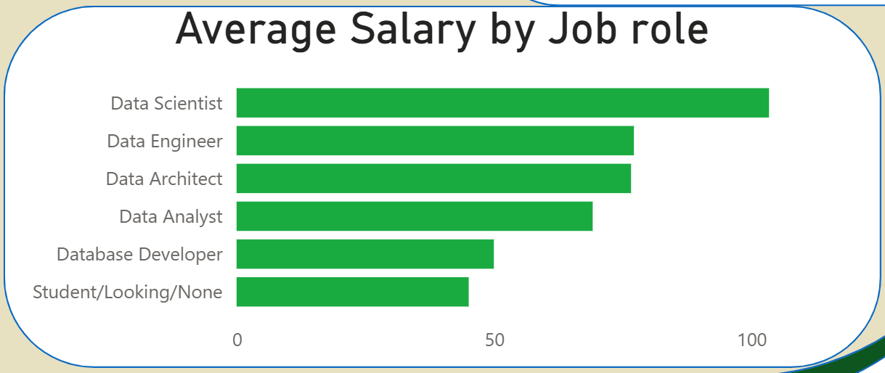
06
What is the Average salary by role job?

Slide 12


Slide 13


